Slide 1


Introduction to Artificial Intelligence
CHANDRADEEP BHATT
Department of CSE
Graphic Era Hill University
Dehradun

Slide 2
INFORMED SEARCH TECHNIQUES
Search with information
Use knowledge to find steps to solution
Quick solution
Less Complexity
Greedy Best first search, A* , Heuristic DFS

Slide 3
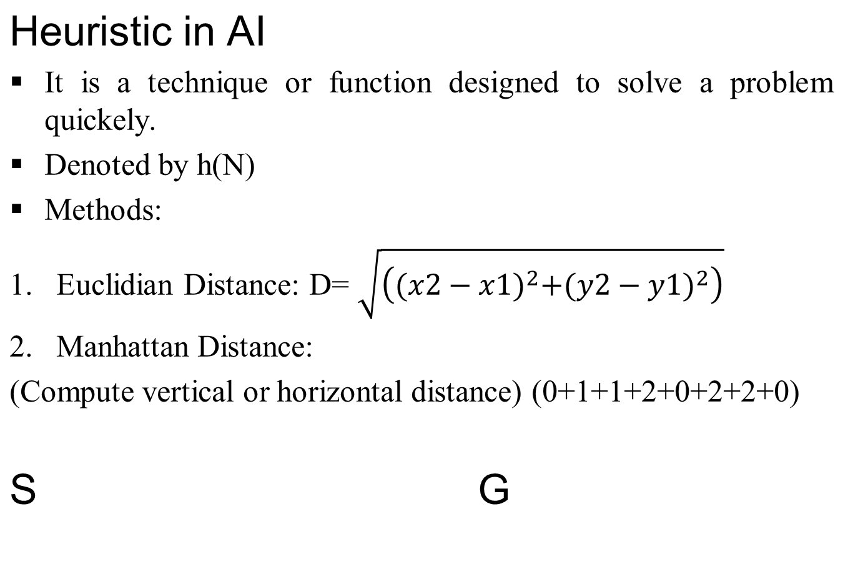
1 | 3 | 2
6 | 5 | 4
 | 8 | 7
1 | 2 | 3
4 | 5 | 6
7 | 8

Slide 4
1. Greedy Best First Search
7
Straight Line Distance
A → G =40
B→ G =32
C → G =25
D → G =35
E → G =19
F → G =17
H → G =10
G → G =0
A
D
25
14
11
F
C
10
B
20
8
15
E
G
11
9
H
10
A → C → F → G

Slide 5
1. Greedy Best First Search
Use Heuristic Function h(n)
A → 10
B→ 8
C → 5
D → 3
E → 0
A
5
C
5
2
2
E
B
6
6
D
Actual cost =10= g(n)
Heuristic function cost =10= h(n)
If g(n) = h(n), Optimal Solution
If g(n) > h(n), Good solution
If g(n) < h(n), Should not admissibility
A → C → E

Slide 6
Performance of Best First Search
Completeness- No
Optimality- No
Time Complexity- O(b^m)
Space Complexity- O(b^m)

Slide 7
A* Algorithm- Informed Search
F(N)= g(N) + h(N)
Actual cost from Start node to n
Estimation Cost from n to Goal node
G
GOAL
SOURCE
S
g(N)
h(N)
N nodes

Slide 8
Example
V
14
12
11
4
B
5
F(S)= 0 + 14 = 14
F(B)= 4 + 12 = 16
F(C)= 3 + 11 = 14
F(E)= 3+ 10 +4 = 17
F(D)= 3 + 7 + 6 = 16
F(G)= 17 + 0 =17
S
F
3
16
12
0
C
10
5
G
11
E
7
4
2
D
6
F
B
S
E
C
E
D
E
G
S → C → D → E →G

Slide 9
Example
V
14
12
11
4
B
5
F(S)= 0 + 14 = 14
F(B)= 4 + 12 = 16
F(C)= 3 + 11 = 14
F(E)= 3+ 10 +4 = 17
F(D)= 3 + 7 + 6 = 16
F(G)= 17 + 0 =17
S
F
3
16
12
0
C
10
5
G
11
E
7
4
2
D
6
F
B
S
E
C
E
D
E
G
S → C → D → E →G

Slide 10
How to make A* admissible
h(n) <= h*(n) --- Underestimation
H(n) >= h*(n) --- Overestimation
CASE1: Overestimation
h(A)= 80
h(B) =70
F(A)=280
F(B)=270
F(G)= g(G) + h(g)= 250
CASE2: Underestimation
h(A)= 30
h(B) =20
F(A)=230
F(B)=220
F(G)=220
Estimated
Actual/ Optimal
40
A
200
S
G
200
B
50

Slide 11
QUE: Provide a detailed explanation of how A* search works, including its algorithmic steps and the role of heuristic functions in guiding the search process.

Slide 12
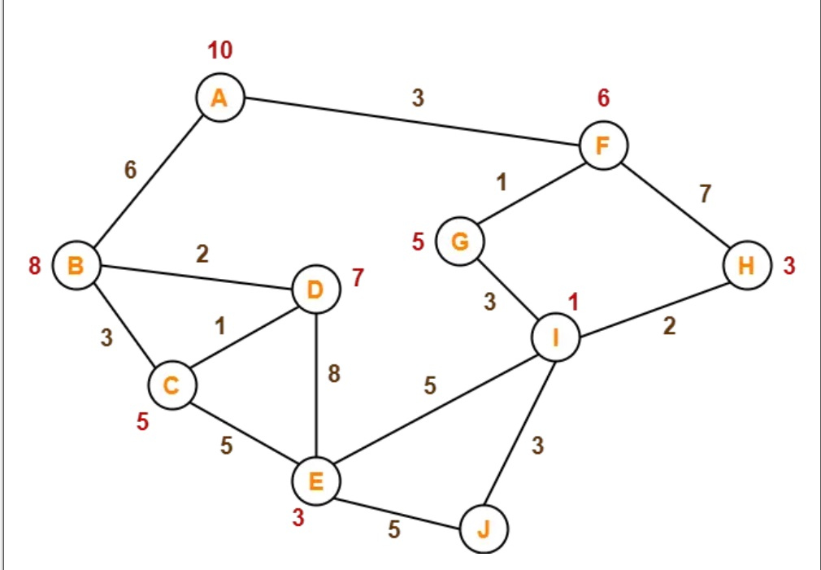
Problem

Slide 13
Thank you

